Slide 1
Chemistry in the Kitchen
Created by Betsey Kennedy
5th grade
Big Shanty Elementary

Slide 2
Essential Question:
In what ways are physical and chemical changes different?
Georgia Performance Standard: S5P2. Students will explain the difference between a physical change and a chemical change.

Slide 3
Table of Contents
Physical Changes
Physical Properties
Activity
Definition
Examples
Chemical Reactions
Definition
Video
Experiment
Examples
Review
Virtual Activity
Click on the at the bottom of each slide to return to the table of contents.

Slide 4
Physical Properties
Physical properties are the characteristics you can observe about an object by using your senses or measuring the object.

Slide 5
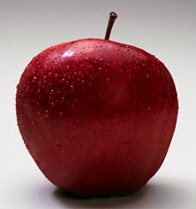
Describe the physical properties of an apple.
How does it feel?
What is the mass?
How wide is it?
How does it taste?
What color is it?
How tall is it?
How much does it weigh?
What shape is it?

Slide 6
How does the apple change when we cut it in half?
Does the size change?
Does the smell change?
Is it still an apple?
Does the taste change?

Slide 7
When we cut an apple, we produce a physical change.
We have only changed the physical properties of the apple.

Slide 8
What is a physical change?
A physical change causes the object to look different but nothing new has formed.

Slide 9
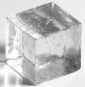
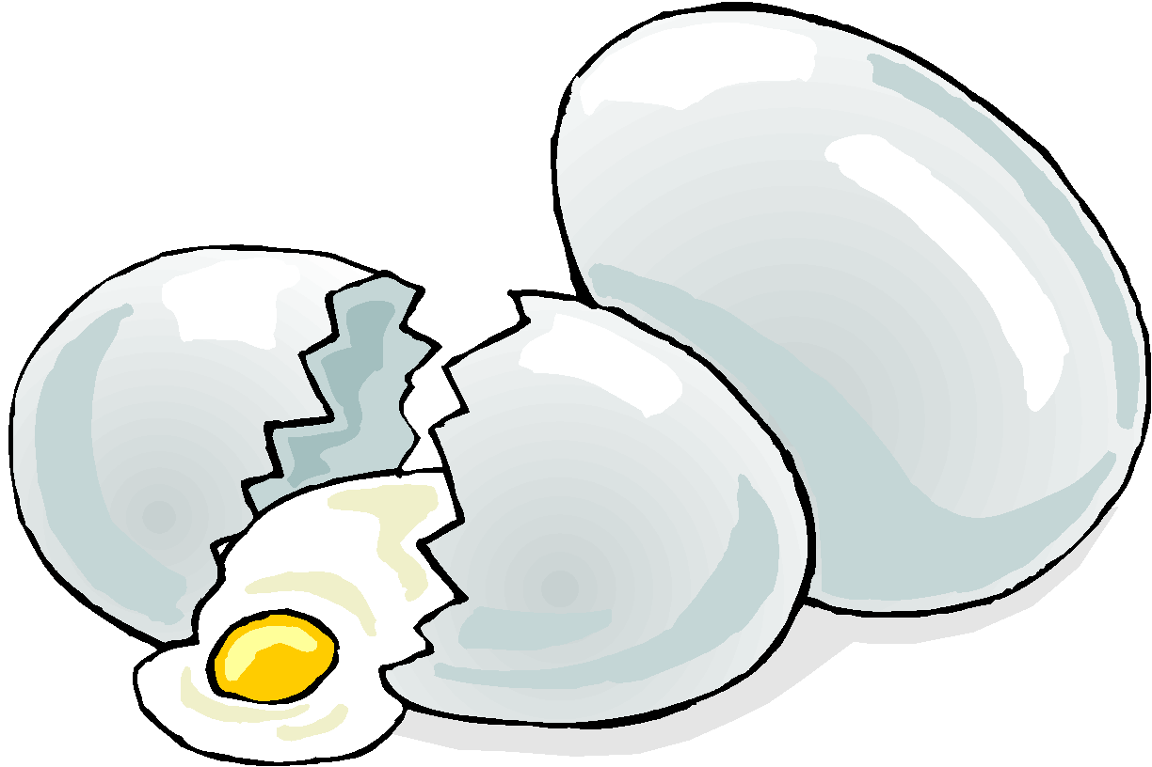
Other Physical Changes
Melting
Kneading
Boiling
Breaking
Freezing

Slide 10
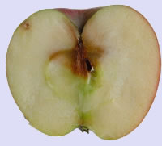
What happened to the apple?
Apples turn brown because the chemicals inside the apple mix with the oxygen in the air. This forms a new substance so it must not be a physical change!
YUCK!
What is it?

Slide 11
A Chemical Reaction!
A new substance forms when a chemical change occurs. The object doesn’t just look different, it is different!

Slide 12
Click on the black box to watch a short video about chemical reactions!
From Peachstar Video Streaming: http://gpb.unitedstreaming.com

Slide 13
Create a Chemical Reaction
Form groups of 3 or more and gather these items: * 3% hydrogen peroxide (do not use a higher percentage) * measuring spoons * yeast (3 teaspoons) * cup (paper or plastic) * thermometer * watch with a second hand or timer

Slide 14
Recording Data
Create a chart like this to record your data.
Notes:
‹#›

Slide 15
Step One:
Pour 2 tablespoons of hydrogen peroxide into a cup. Place the thermometer into the cup. Read the temperature and record it in the chart under “0 sec.".
Notes:
‹#›

Slide 16
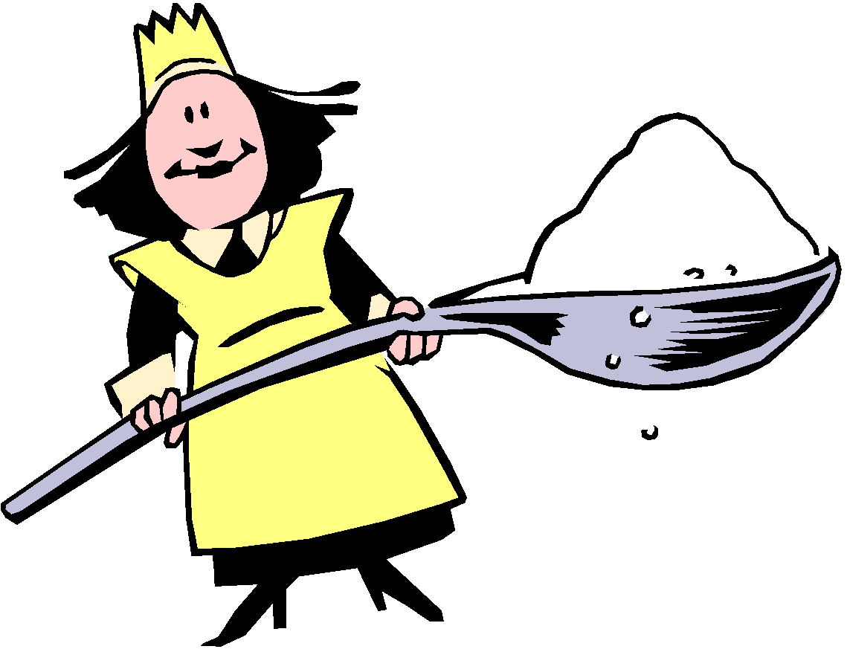
Step Two:
Put three tablespoons of yeast into the cup. Gently swirl the cup. One partner should call out the time every 10 seconds. When each 10 seconds is called, another partner should read the temperature. The third person should record the temperature on the chart.

Slide 17
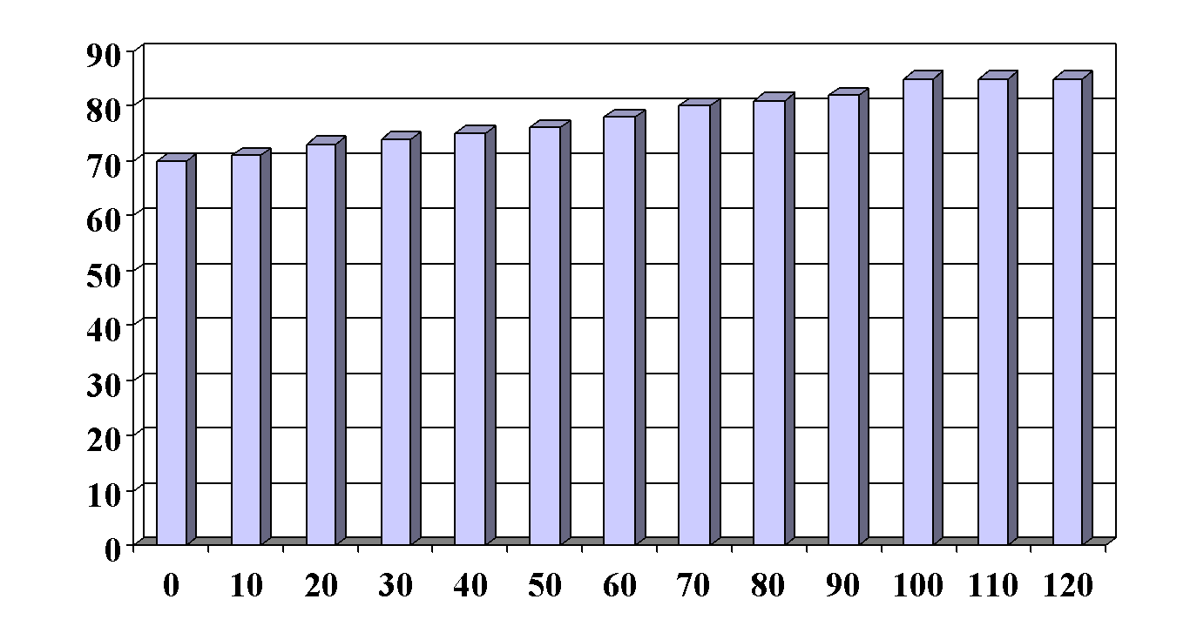
Graph your results!
Temperature
Time (seconds)

Slide 18
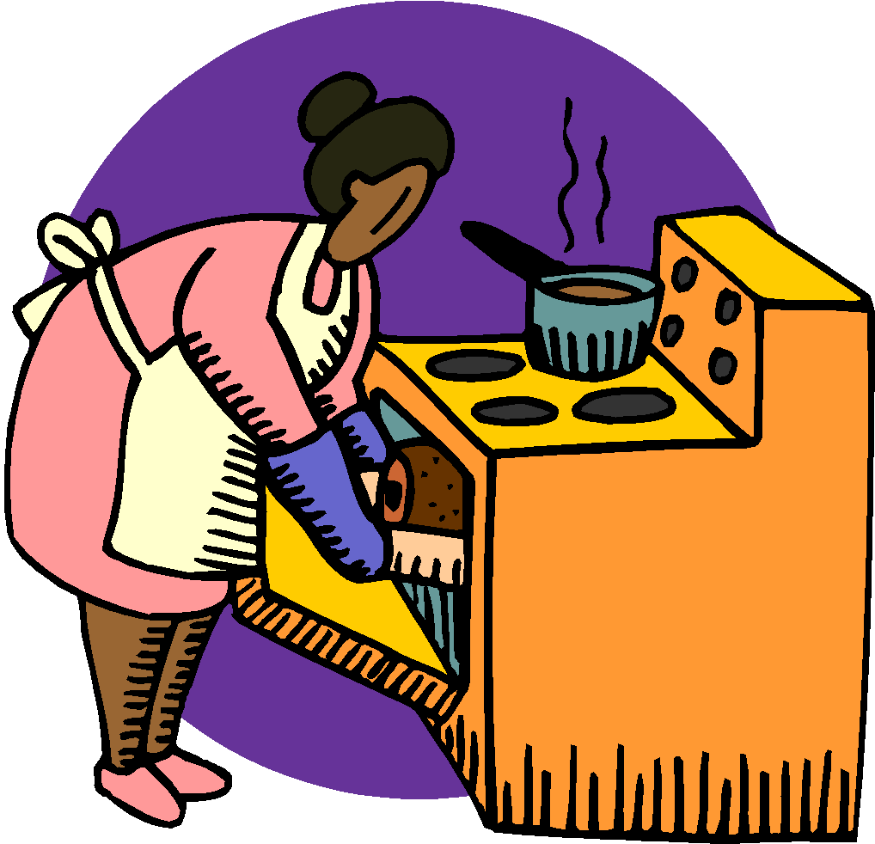
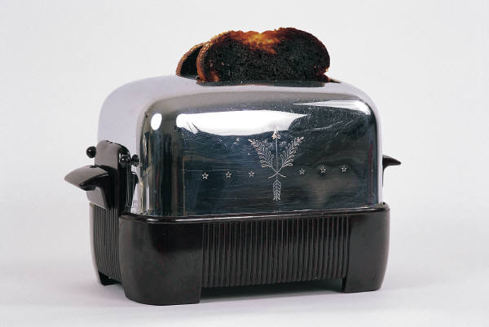
Other Chemical Reactions
Burning Foods
Baking a Cake
Tarnishing Silver
Digesting Food

Slide 19
A Quick Review
No new substances formed
Physical Change
New substances formed
Chemical Reaction

Slide 20
A Quick Review
What other examples of physical and chemical changes can you find?

Slide 21
Virtual Kitchen
Click on the cabbage below to experiment with acids and bases in the kitchen!

Slide 22
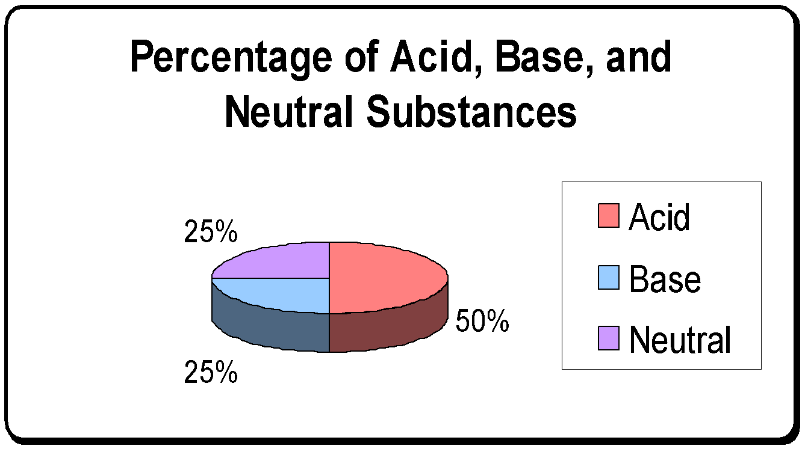
Virtual Kitchen Results

Slide 23
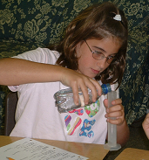
Images
All graphics used in this PowerPoint are assumed to be free and/or public domain. If I used a copyrighted graphic in error, please contact me at my email address immediately so that I may give proper credit or remove the graphic from my site.

